Slide 1


Administrator Essentials

Slide 2
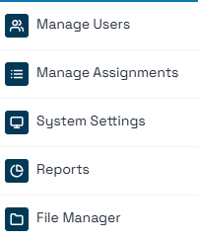
InfoSight360: Admin Menu Options
Admin Users Only
User Role Defined*
Admin Users Only
Admin Users Only
User Role Defined

Slide 3
Managing Users
Overview
User Types
In the InfoSight360 system there are two types of users: “Admin” and “User.”
Admin-level gives full access to all content and all functions within the system.
User-level is more restricted. Users will have full access* to InfoSight, they can see their own assignments, and can view the CU Documents area (but viewing files within CU Documents may be restricted)
Roles
Roles can be created and added to User-level profiles to augment viewing and access rights.
Additional viewing rights general areas of the site, including files in CU Documents, News & Announcements, and Support
Additional viewing or editing rights for CU PolicyPro/RecoveryPro, such as viewing and/or editing content or published documents, managing assignments, and managing files.
*Note: InfoSight access is limited to affiliated credit unions

Slide 4
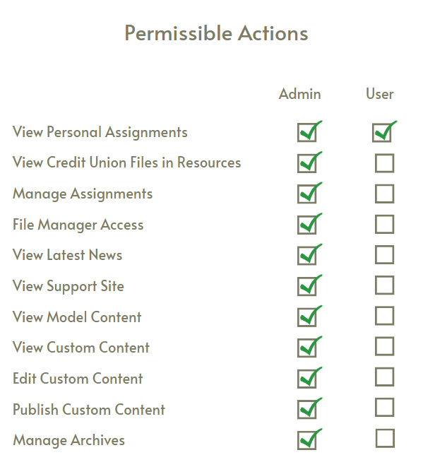

InfoSight Access
View Personal Assignments
View CU Documents*
View Published Documents*
View Latest News
View Support Site
View System Documentation
View Model Content
View Custom Content
Edit Custom Content
Publish Custom Content
*Note: Access may be limited

Slide 5
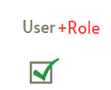
InfoSight Access
View Personal Assignments
View CU Documents*
View Published Documents*
View Latest News
View Support Site
View System Documentation
View Model Content
View Custom Content
Edit Custom Content
Publish Custom Content
*Note: Access may be limited

Slide 6
InfoSight Access
View Personal Assignments
View CU Documents*
View Published Documents*
View Latest News
View Support Site
View System Documentation
View Model Content
View Custom Content
Edit Custom Content
Publish Custom Content
*Note: Access may be limited

Slide 7
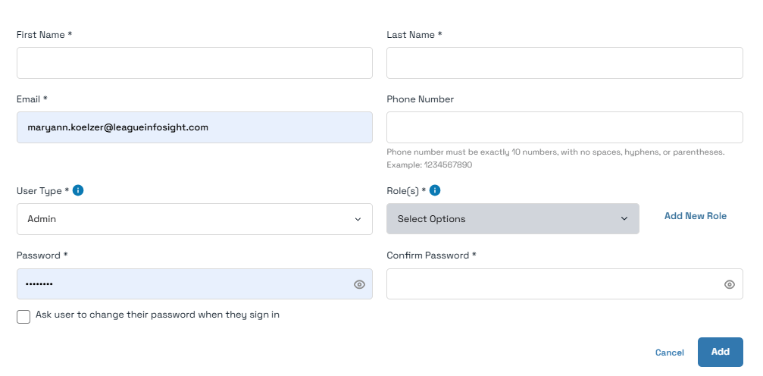
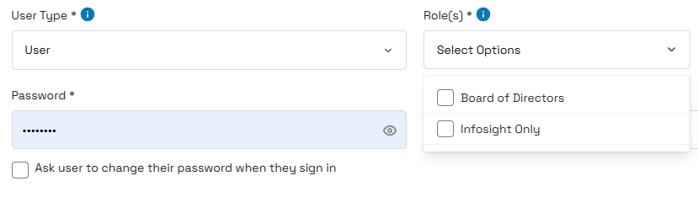
Managing Users

Slide 8
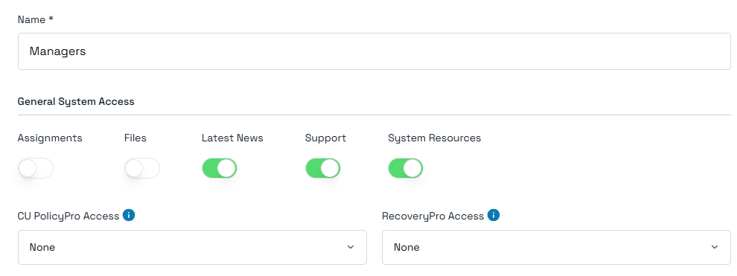
Managing Roles: General System Access
General System Access: choose which general areas or functions the Role has access to
Assignments: Gives the user full access to create, edit, and delete assignments for all users for any product the credit union subscribes to
Files: Gives the user full access to File Manager to upload, view, move, and delete files, and to assign access rights to files
Latest News: Gives the user access to view “News & Announcements” on the Home Page
Support: Gives the user access to view the Support site
System Resources: Gives the user access to view CU PolicyPro and/or RecoveryPro system-related documents such as Sample Forms and worksheets

Slide 9
Managing Roles: General System Access
General System Access: choose which general areas or functions the Role has access to
Assignments: Gives the user full access to create, edit, and delete assignments for all users for any product the credit union subscribes to
Files: Gives the user full access to File Manager to upload, view, move, and delete files, and to assign access rights to files
Latest News: Gives the user access to view “News & Announcements” on the Home Page
Support: Gives the user access to view the Support site
System Resources: Gives the user access to view CU PolicyPro and/or RecoveryPro system-related documents such as Sample Forms and worksheets (if the user has access to the product)
High
High
Low
Low
Low

Slide 10
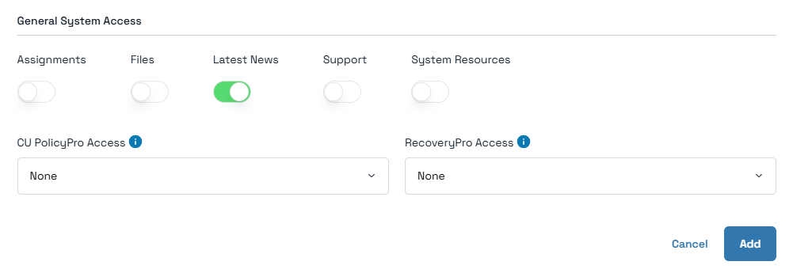
Example: InfoSight Only
User can view:
InfoSight
Their own assignments (if any)
Uploaded documents which they have been given permission to view
News & Announcements

Slide 11
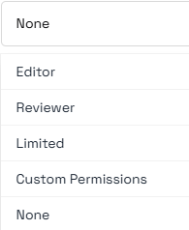
Managing Roles: Product Access

Slide 12
Managing Roles
Product Access Details:
None: User has no access to this product

Slide 13
Managing Roles
Product Access Details:
Editor: this role provides full access to view and manage all content for the corresponding product. This includes viewing and importing model content, viewing and editing all credit union custom content, archiving, and publishing.
Very High

Slide 14
Managing Roles
Product Access Details:
Reviewer: this role provides full access to view all content for the corresponding product. This includes viewing the model content, all credit union custom content, and all published documents.
High

Slide 15
Managing Roles
Product Access Details:
Limited: this role allows the user access to the Published Documents area where they can only view Published Documents they have been specifically authorized to view.
They cannot view model content.
Low

Slide 16
Managing Roles
Product Access Details:
Custom Permissions: this role is used to create tailored access to view and/or manage content for specific users.
Varies

Slide 17
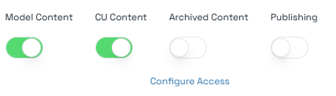
Managing Roles
Product Access Details:
Custom Permissions: this role is used to create tailored access to view and/or manage content for specific users.
Model Content: allows user to view all model content for the corresponding product.
CU Content*: allows users access to view and/or manage specific sections of the credit union’s custom content for the corresponding product.
Archived Content: allows the user full access to the Archived Content area for the corresponding product. This includes viewing and restoring previous versions of all custom content and restoring any deleted content.
Note: Content selected in “Configure Access” is not applied to Archived content – users will have access to all content
Publishing: allows the user full access to the Publishing area of the corresponding product. This includes viewing all published documents, creating new published documents, and manage existing published documents.
Note: Content selected in “Configure Access” is not applied to Publishing – users will have access to publish all content and view all published documents.
Low
Varies
High
High

Slide 18
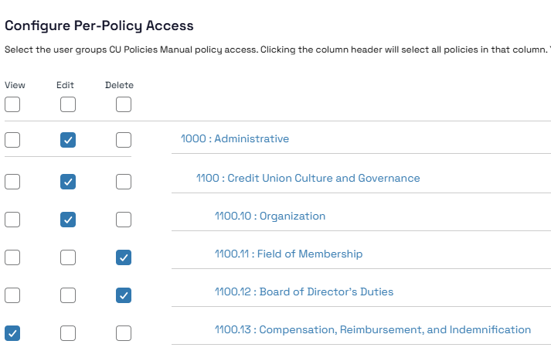
Managing Roles
Product Access Details:
Custom Permissions: this role is used to create tailored access to view and/or manage content for specific users.
CU Content*: allows users access to view and/or manage specific sections of the credit union’s custom content for the corresponding product.
If this option is selected, a “Configure Access” button will appear which is used to select specific permissions for specific content sections (the “Configure Access” step must be completed for the user to view/manage any custom content).
Varies

Slide 19
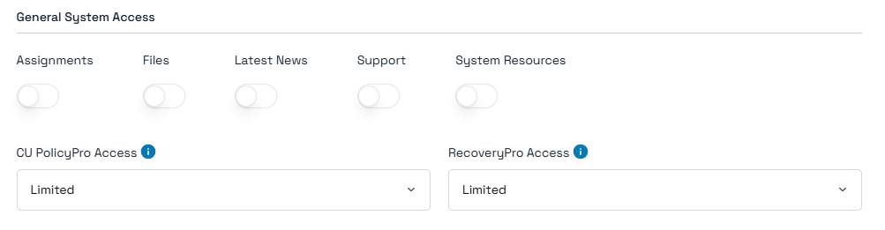
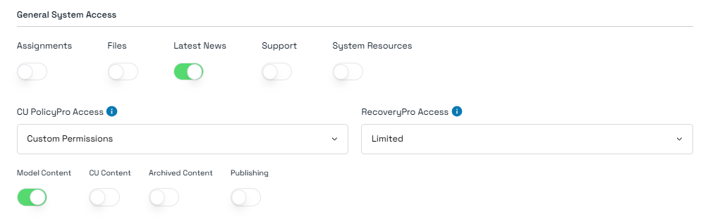
Example: Board of Directors
User can view:
InfoSight
Their own assignments (if any)
Uploaded documents which they have been given permission to view
Published Documents (CUPP and RP) they have been given permission to view
User can view:
InfoSight
Their own assignments (if any)
Uploaded documents which they have been given permission to view
Published Documents (CUPP and RP) they have been given permission to view
Model CU PolicyPro content
News & Announcements

